Slide 1

Amazon’s product sales data
FINAL PROJECT-GROUP12

Slide 2

STEPS INCLUDED IN PROJECT
Introduction
Problem Statement
Business Understanding
Data Understanding
Data Preparation
Queries and Visualization

Slide 3


INTRODUCTION
E-commerce, often known as electronic commerce, is the exchange of goods and services and sending of money and data through an electronic network, most commonly the internet.
The widespread use of e-commerce sites like Amazon and eBay over the past 20 years has significantly boosted the growth of online retail. The U.S. Census Bureau estimates that 5% of all retail purchases in 2011 were made through e-commerce. As the COVID-19 pandemic broke out in 2020, it had increased to over 16% of retail sales.

Slide 4

Which category of products are impacting sales?
Products with a high cost and a low rating.
Products with a high discount price and a low rating.
Products with a good rating and a low review count.
4

Slide 5
BUSINESS UNDERSTANDING
To analyze the category of products that are killing the company's profits.
To analyze the rating of the products based on discount percentage.
To analyze the products with a high cost and low rating.
To analyze the category of products with a high discount price and a low rating.
To analyze the products with a high rating and an intense review count.

Slide 6
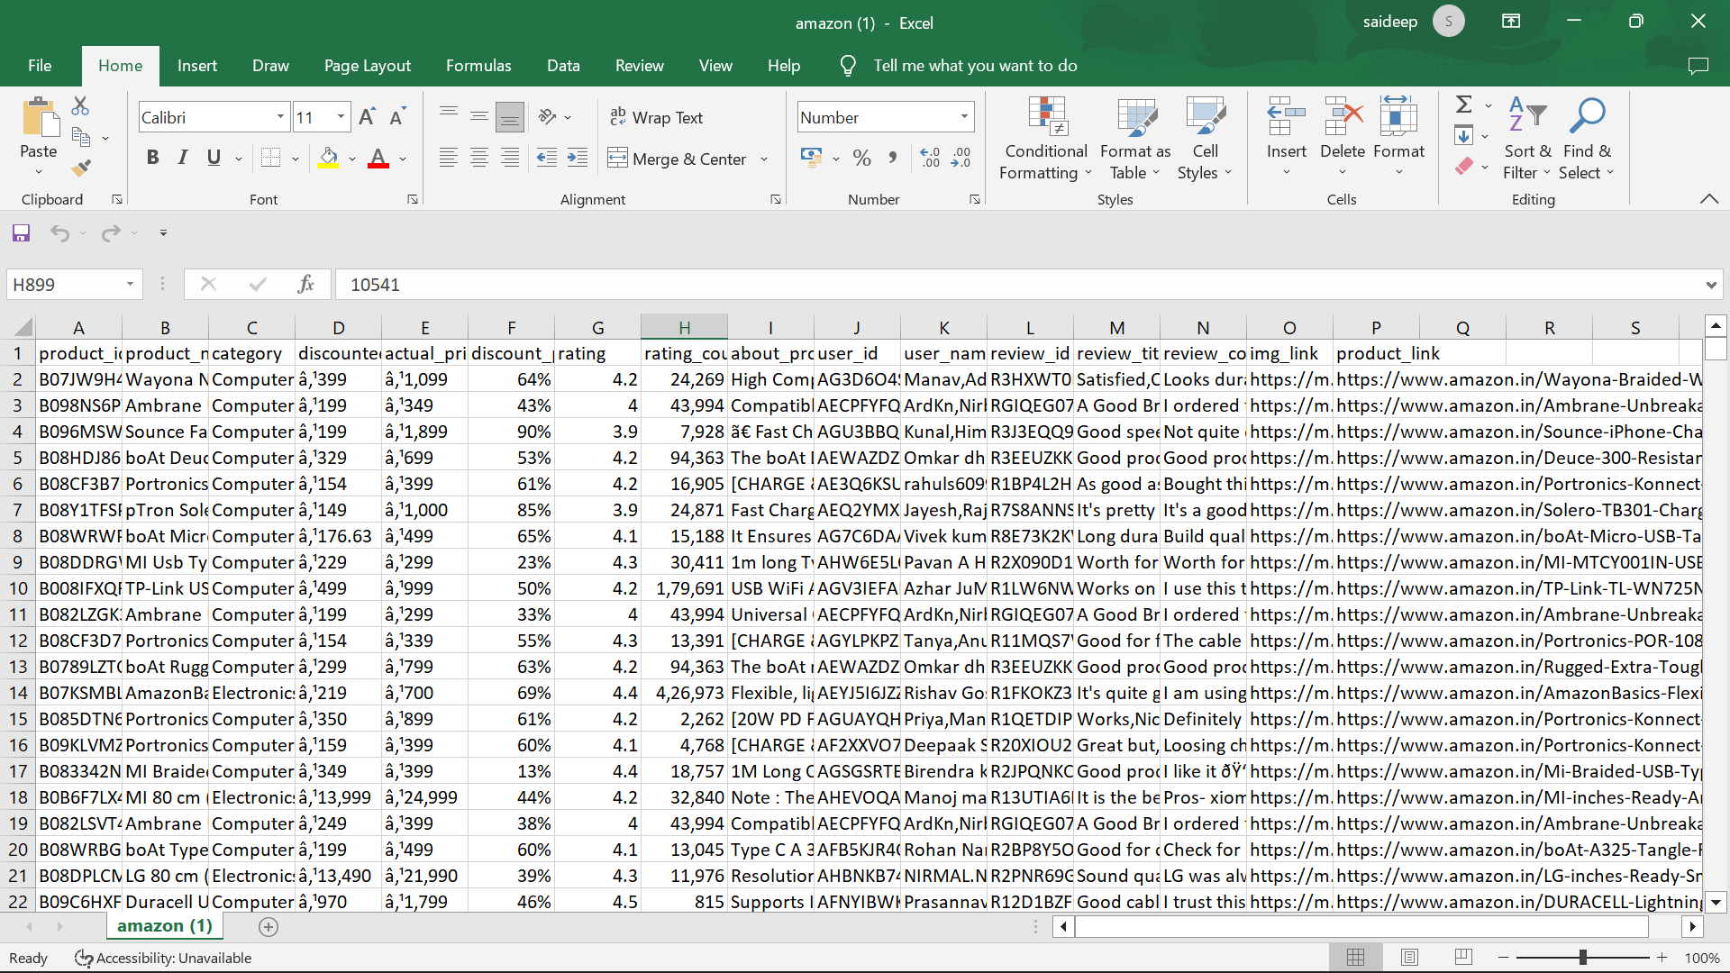

Data Understanding

Slide 7
AMAZON SALES DATASET
Original CSV retrieved from Kaggle.com.
Here is the link for the mentioned dataset.
https://www.kaggle.com/datasets/karkavelrajaj/amazon-sales-dataset
This dataset contains data from 1466 Amazon products' ratings and reviews as listed on Amazon's official website.

Slide 8
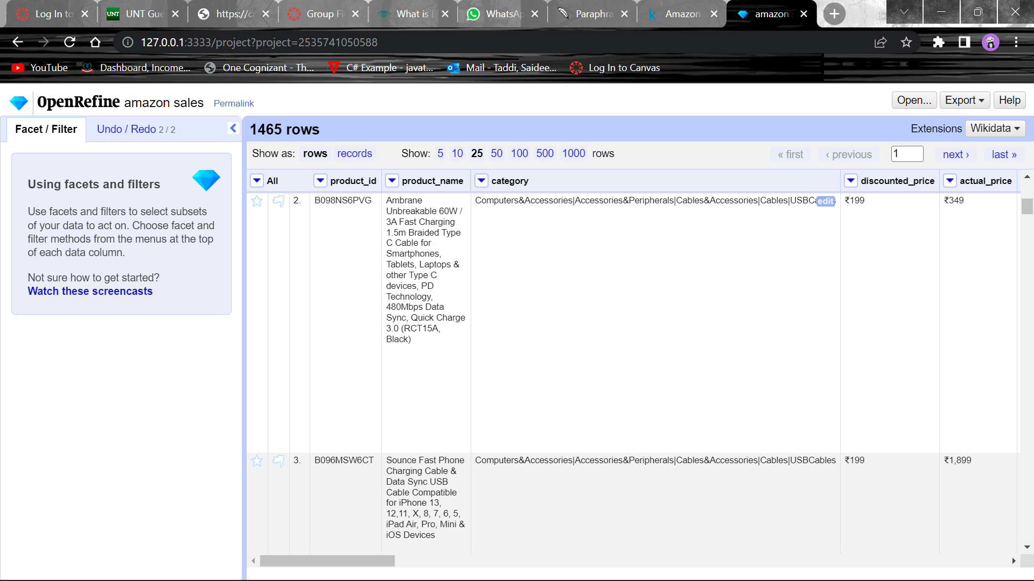
DATA PREPARATION
The data was prepared for further analysis using Open Refine.
Text facets were utilised to check for typos/misspellings in the text entries. There were no errors.
The common transforms function in OpenRefine was used to "text to number" convert the rating and rating count columns.
We used Big Query on GCP to prepare the data, execute the commands, and get the necessary outcomes.

Slide 9



DATA PREPARATION – DATA COLUMNS
product_id
product_name
category
discounted_price
actual_price
discount_percentage
Rating
rating_count
about_product
user_id
user_name
review_id
review_title
review_content
img_link
product_link

Slide 10
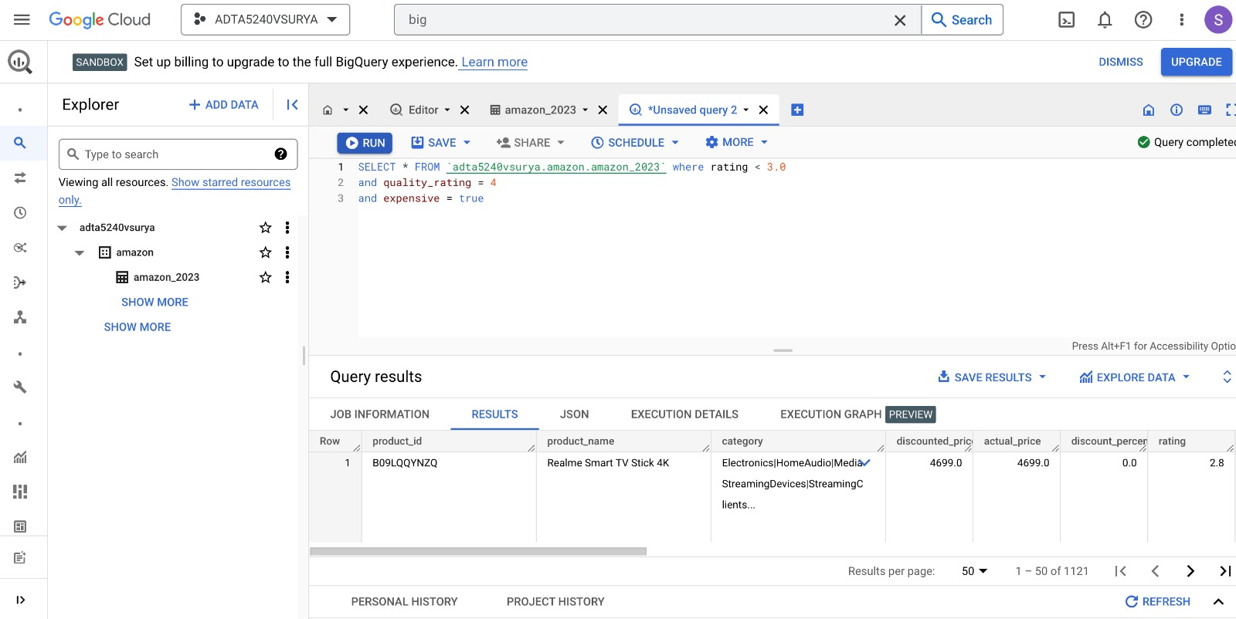
Products with low rating and expensive The query shows the products which has lower overall ratings, but the quality rating is 4, so this shows that the decrease in the price will result in the increase in revenue.

Slide 11
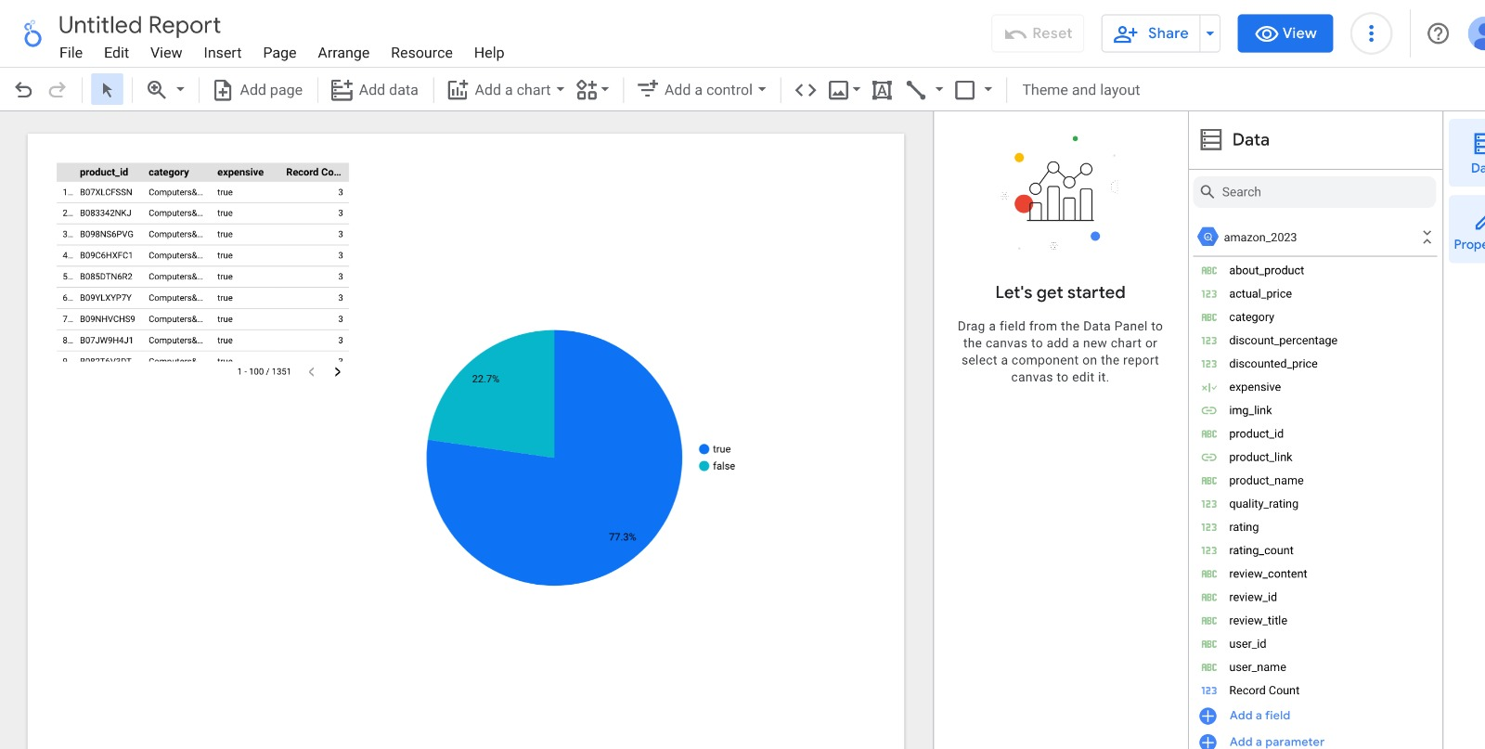
Data Visualization
The pie graph shows the customers ratings on the products which were expensive. So, 77.3% of the users says that the products have good quality, but they are expensive. This is one of the reasons that is killing the sales of the company.

Slide 12
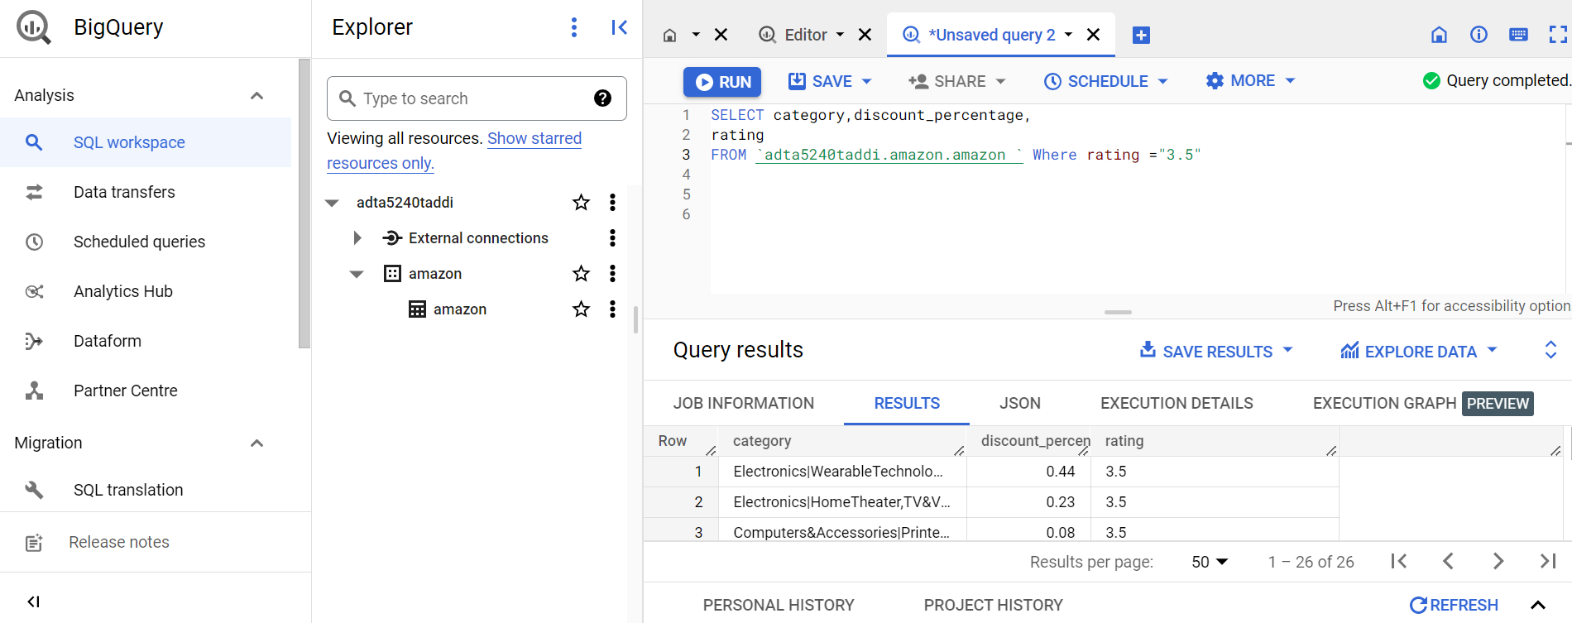
Category of products where rating is equal to 3.5
The query shows the products which have average rating(3.5) and good discount percentage.
From this we can get to know a product with decent discount price will get a average rating.
12

Slide 13
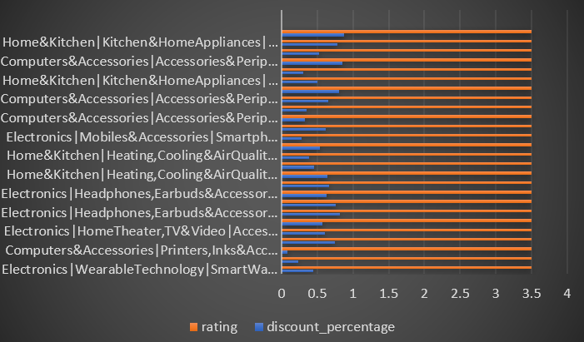
DATA VISUALIZATION
This chart have category of products on y-axis and discounted price,rating on x-axis which shows that product with decent discount price will get average review.
These products will help in the growth of sales of the company.
13

Slide 14
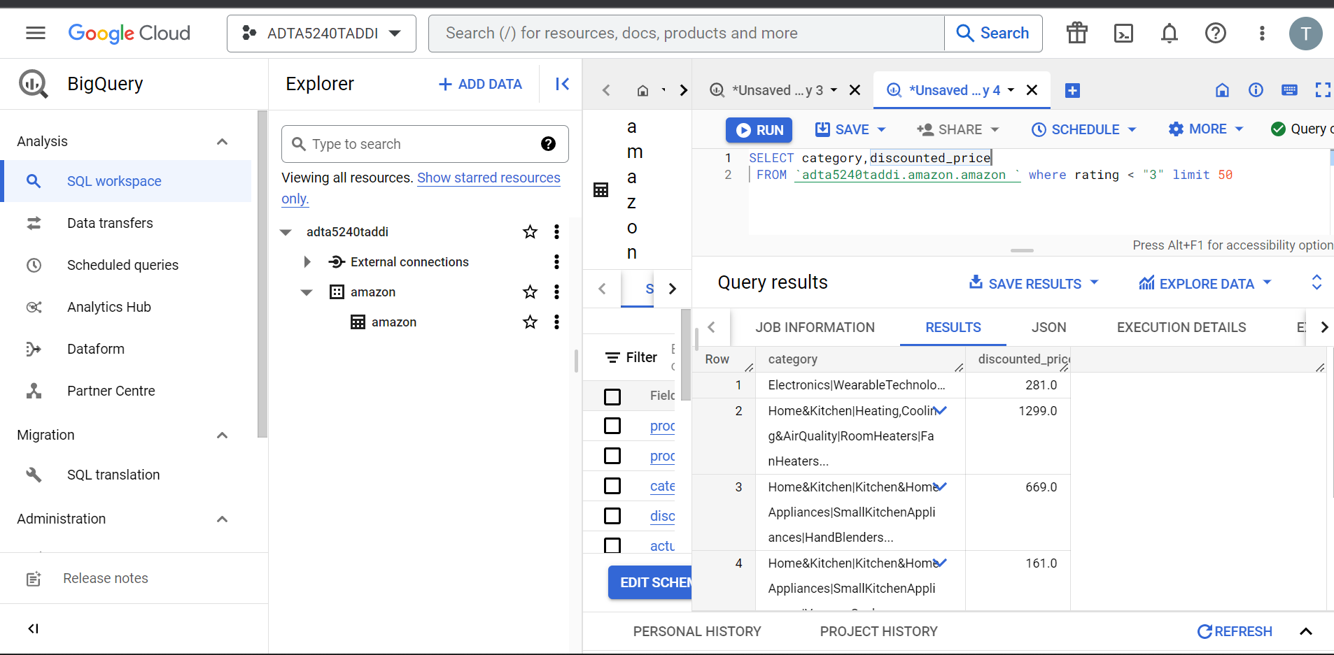
Category of products which has low rating.
This query will reveal the goods with low ratings and returns the categories and discounted price columns. This will help Identify and eliminate any products with low ratings from the website.
14

Slide 15
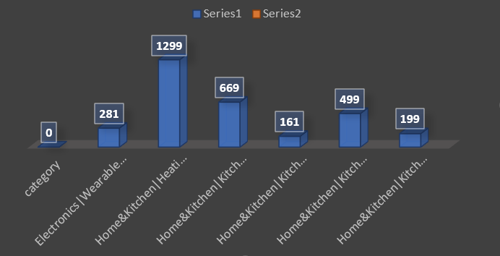
Data visaualization
This chart shows the discounted pricing as well as the product category with the lowest rating.
In order to stop harming the company's sales, we can remove these items from the website.
15

Slide 16
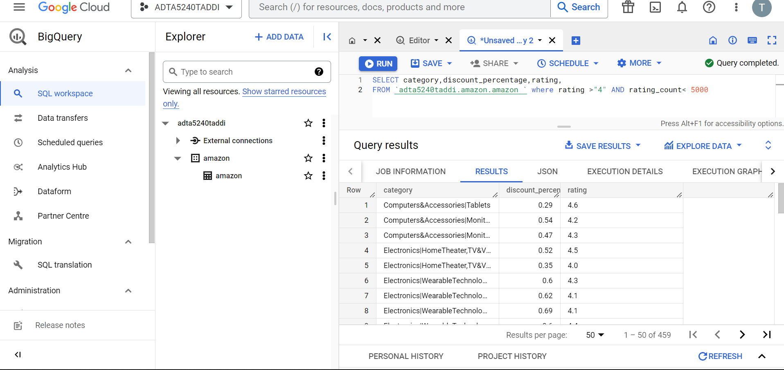
Category of products with good rating and less reviews
We can explore about products with high ratings and few reviews by using this query.
Despite having a good rating, a product with few evaluations will not aid in the expansion of the business.
16

Slide 17
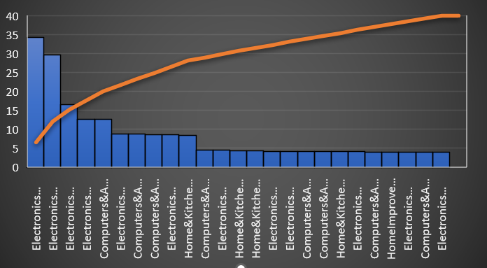
Data visualization
The number of reviews is on the y-axis in this chart, and the product category is on the x-axis.
We can clearly see the amount of reviews, and even though they have high ratings, categories with less reviews may be removed from the website. This will contribute to the company's profits rising.
17

Slide 18

Any Questions and Comments?
18

Slide 19

THANK YOU
FINAL PROJECT
GROUP-12

